Slide 1
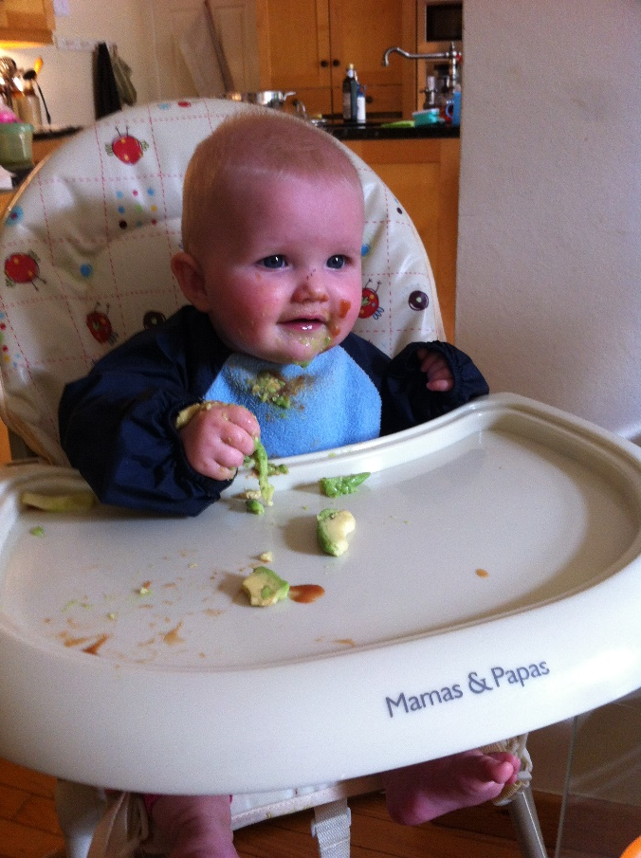
All in the best possible taste… aka Food and Drink Round

Slide 2
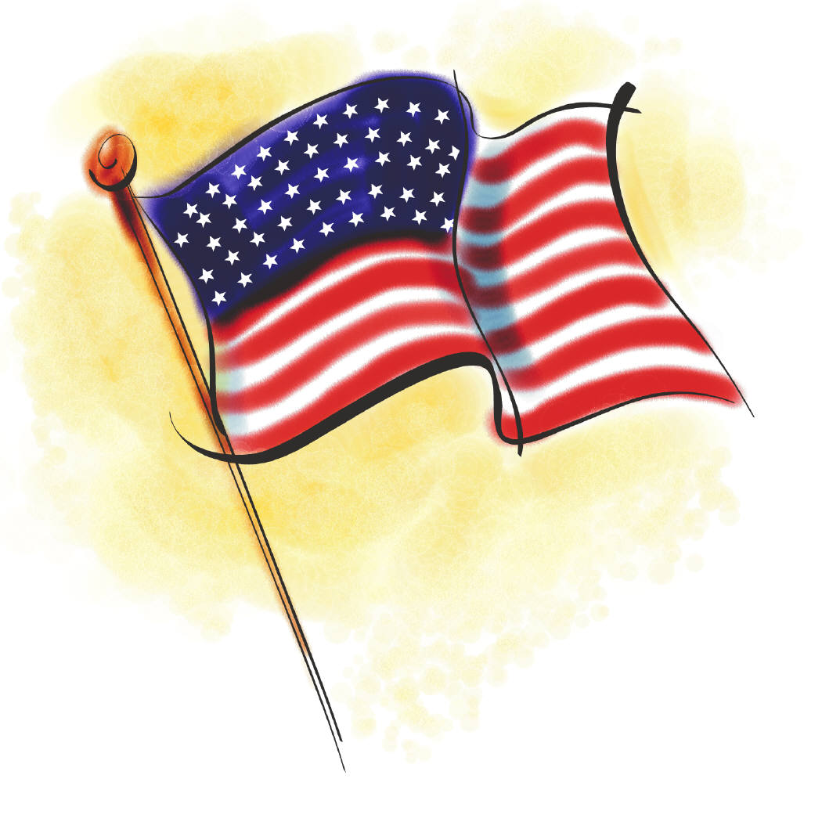
1. By what name is a courgette more commonly known in America?

Slide 3
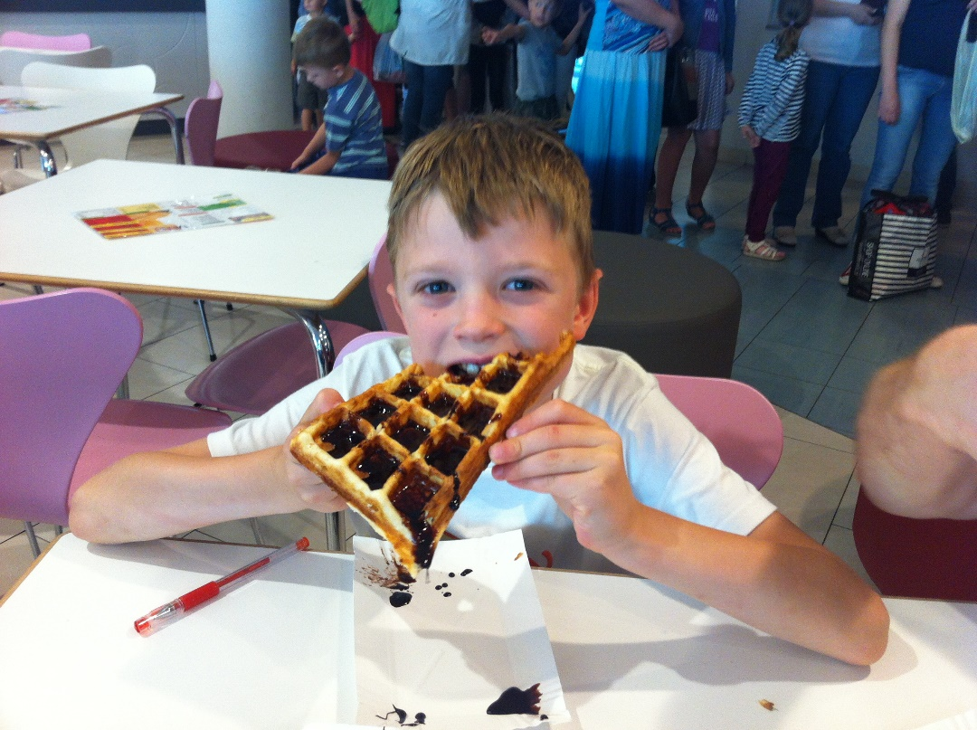
2. In 2014, Turkey, Ireland, and the UK rank first, third and fifth in the world in the consumption of what? (Wikipedia)

Slide 4
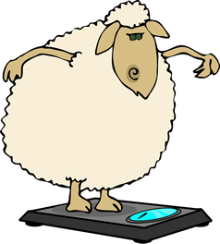
3. Haggis is a traditional Scottish sausage made from a sheep’s stomach stuffed with what 4 main ingredients? (excluding onions)

Slide 5
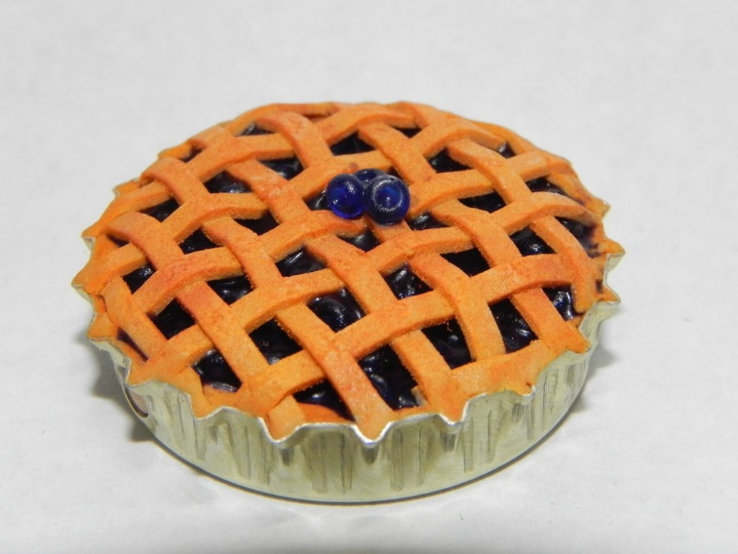
4. If apple pie is the official state pie of Vermont and blueberry pie of Maine, what is the official state pie of Florida?

Slide 6
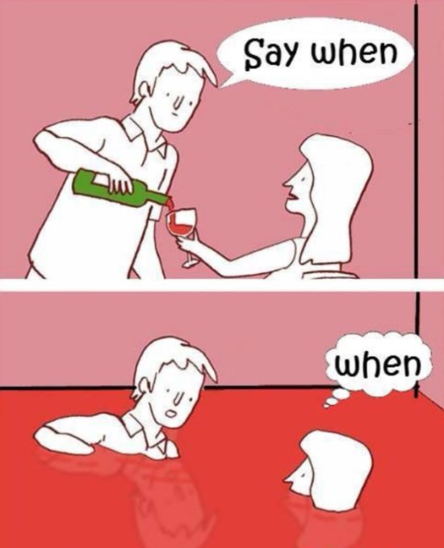
5. What part of a wine bottle is the punt?

Slide 7
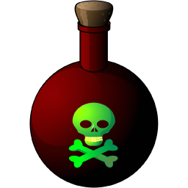
6. What poison is found in (small quantities!) in rice?

Slide 8
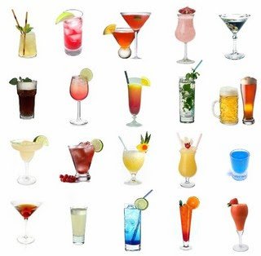
7. Name the popular drink that was invented by John Pemberton in 1886?

Slide 9
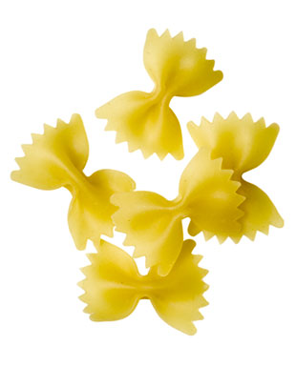
8. Name the pasta

Slide 10
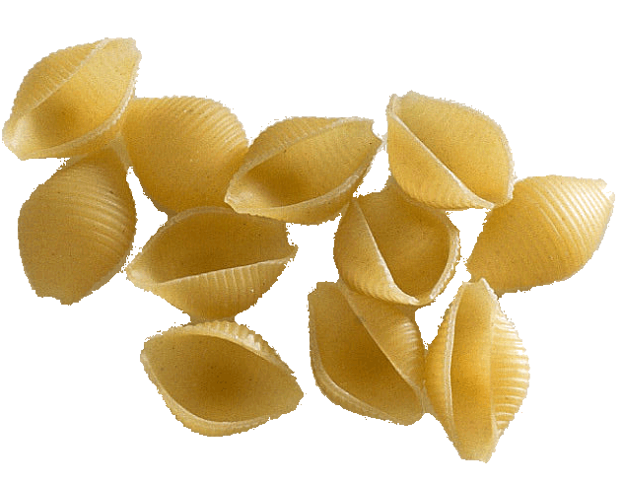
9. Name the pasta

Slide 11
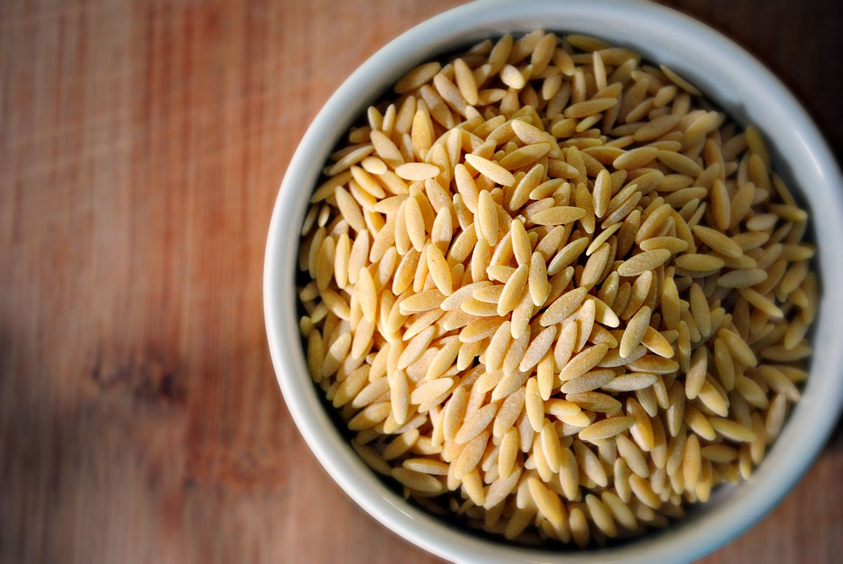
10. Name the pasta

